Slide 1
ebooks
Accessing eBooks at North Greenville Elementary School in the Library, Classroom, at Home, or Anywhere.

Slide 2
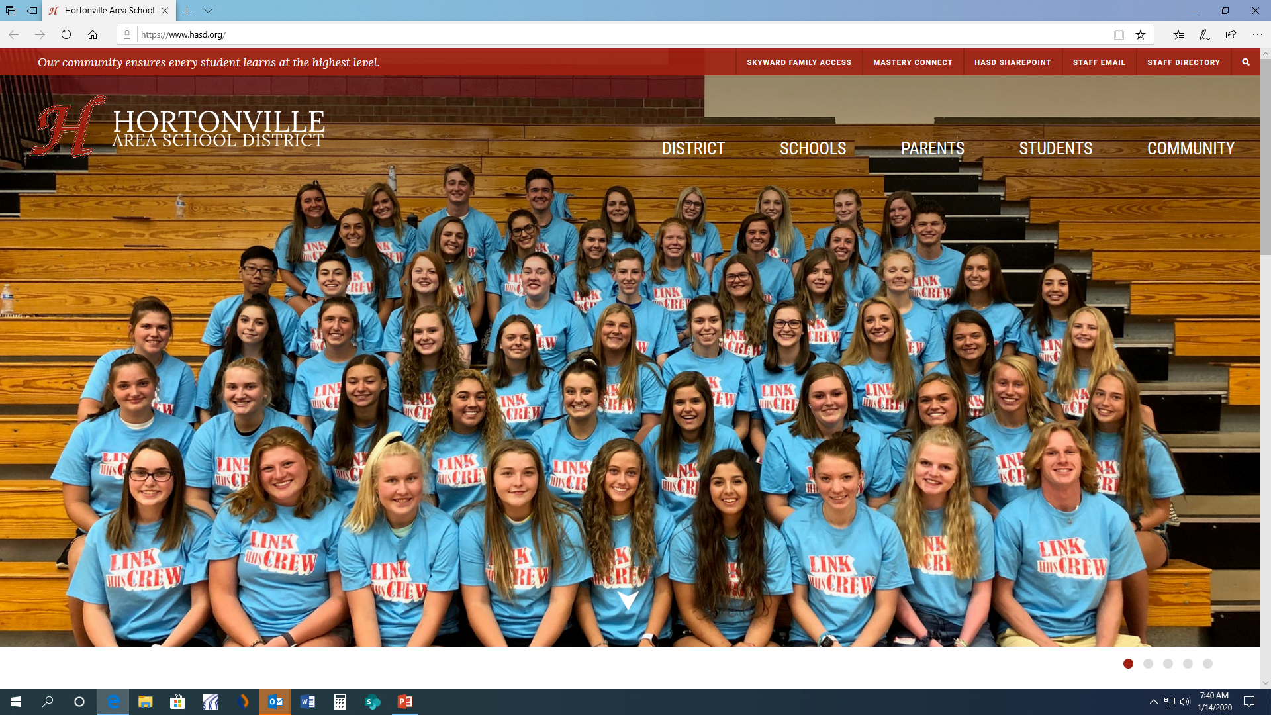
Let’s Get Started:
Log onto the computer and open Microsoft Edge and open the HASD website “https://www.hasd.org”

Slide 3

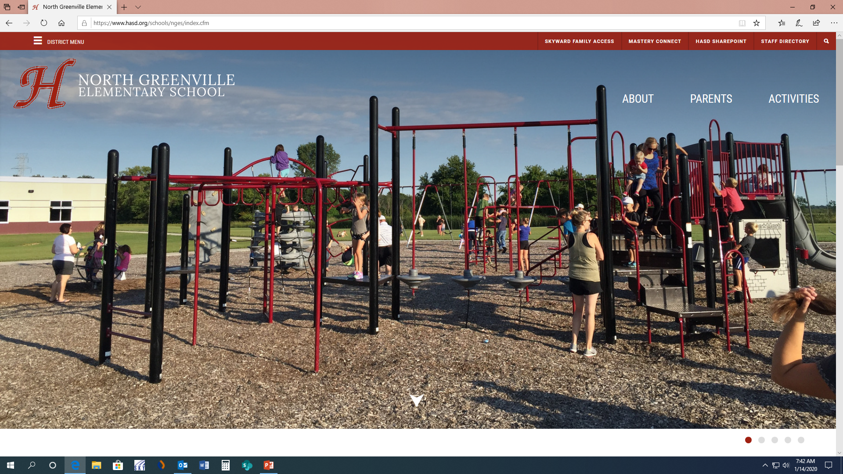
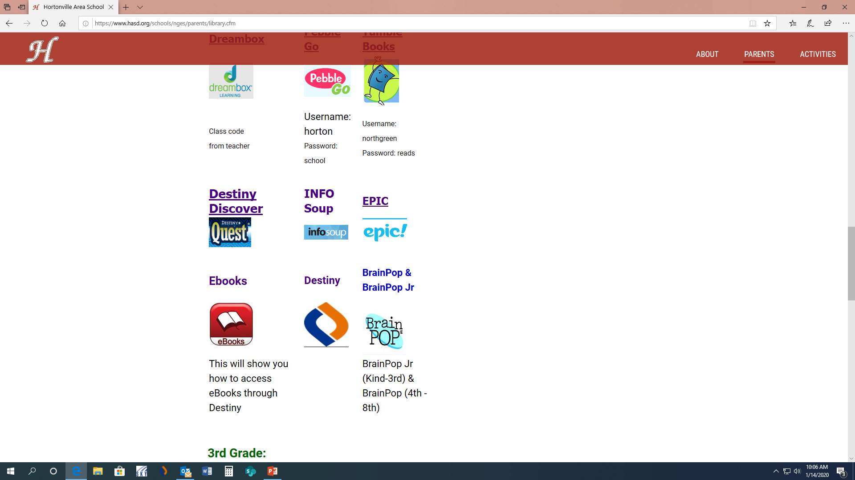
* Under “Schools” go to the
“North Greenville Elementary School” website.
*Under “Parents” go on the “Library” website
*Click on “Destiny” in the middle of the page.

Slide 4
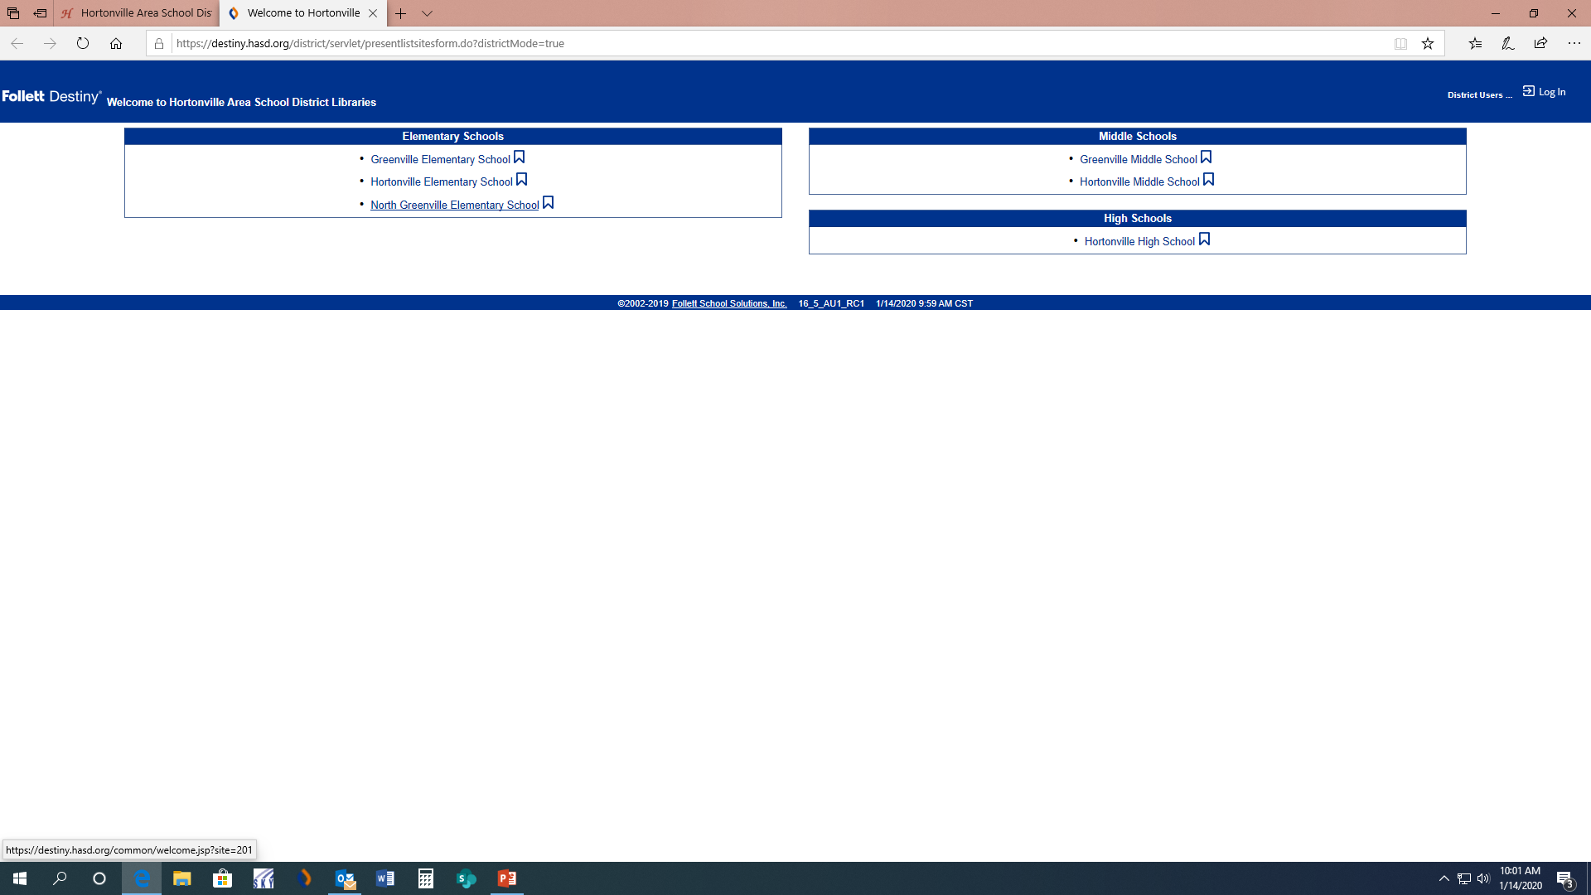
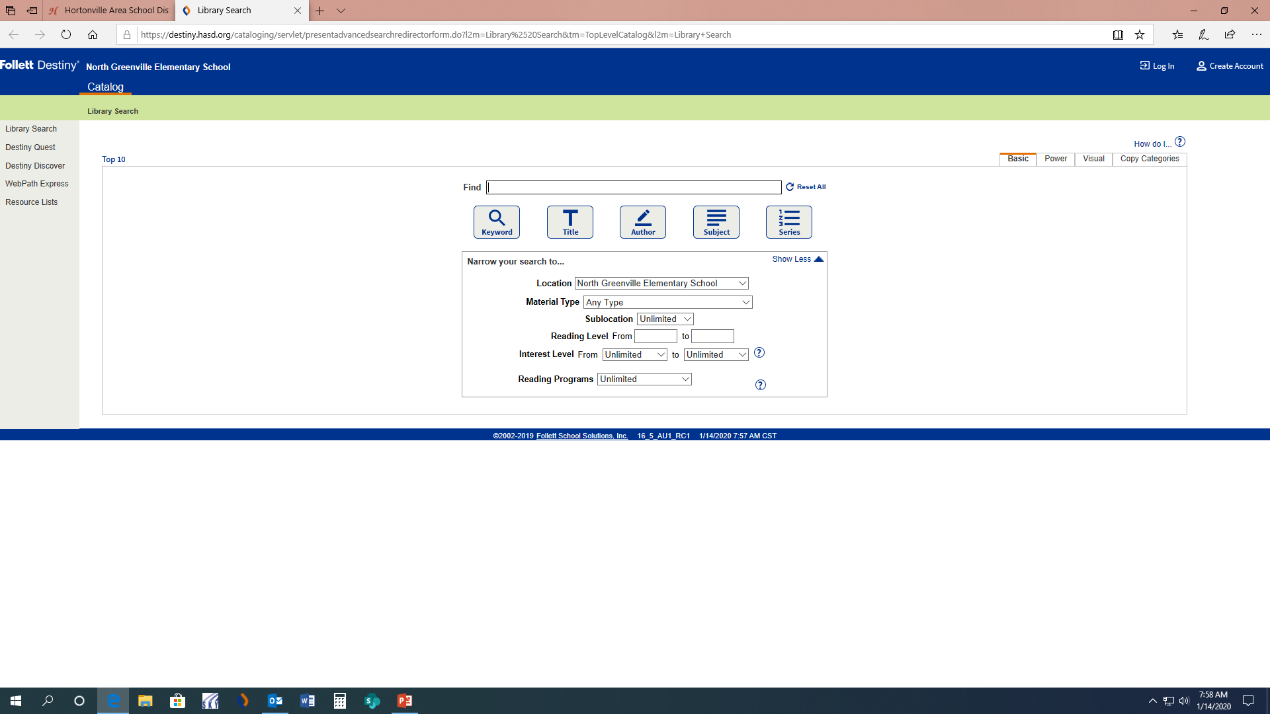
Logging into Destiny
Click on “North Greenville Elementary School “
Click on “login”
on THE top

Slide 5
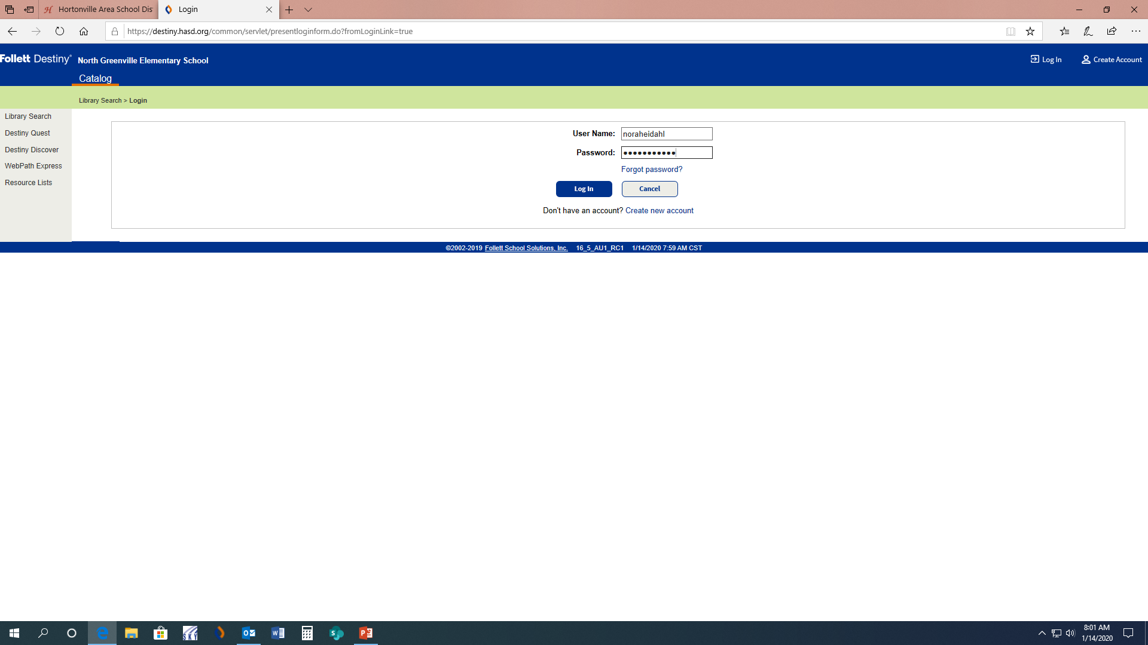
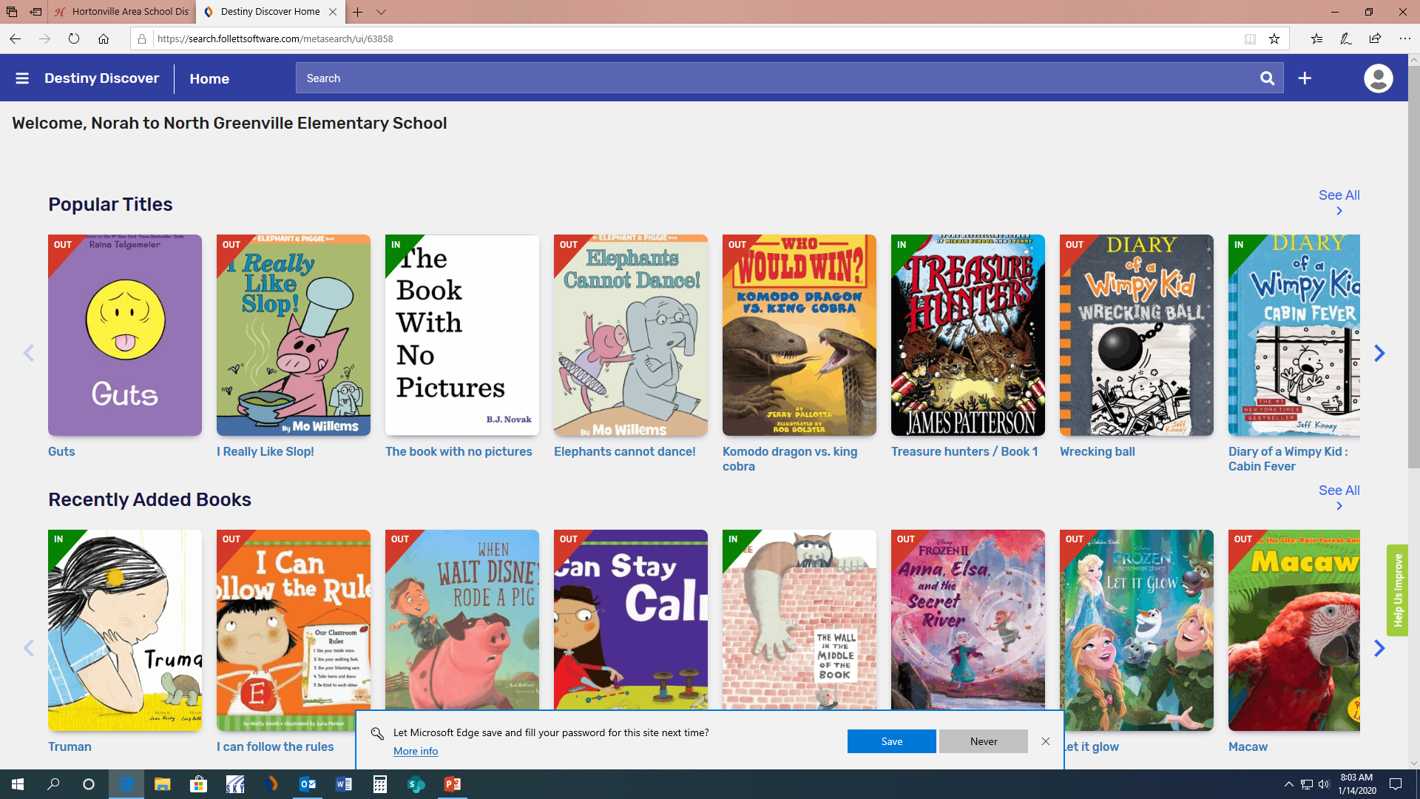
Destiny Discover Login
User Name = student’s first and last name (no space)
password = student.123
This will get you to your destiny Discover home screen

Slide 6
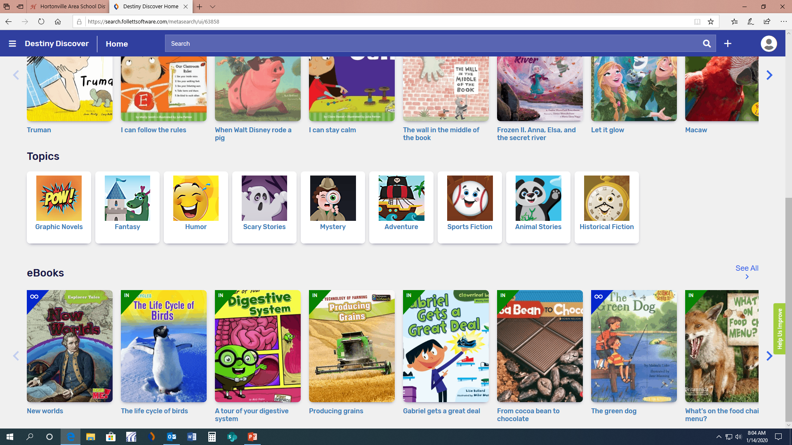
Under “eBooks” in the middle of the page, select “See All” on the right-hand side.

Slide 7
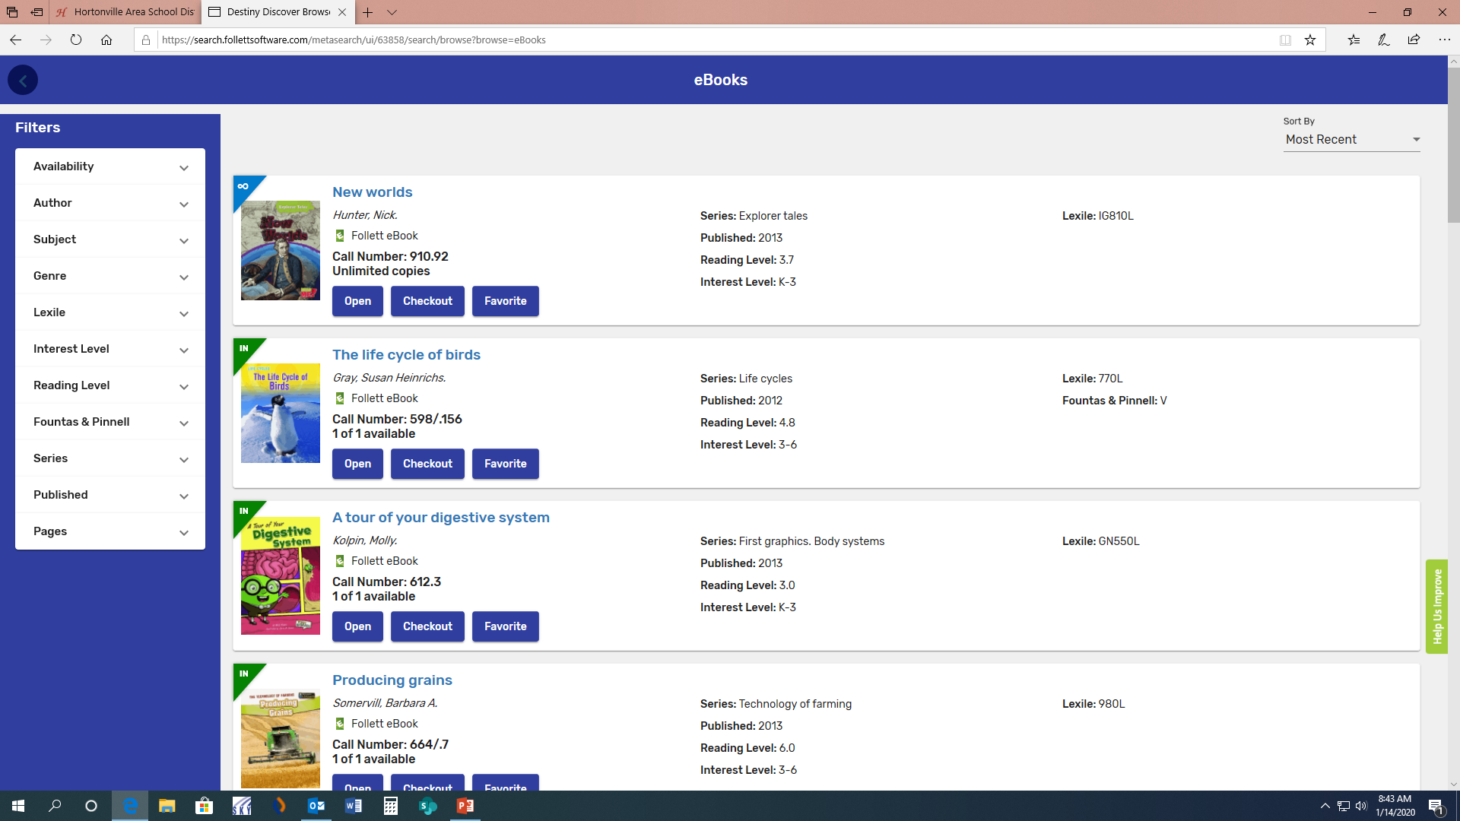
Destiny Discover eBook Screen
From here, you can open an eBook, you can check one out, or you can review and mark as your favorite.

Slide 8

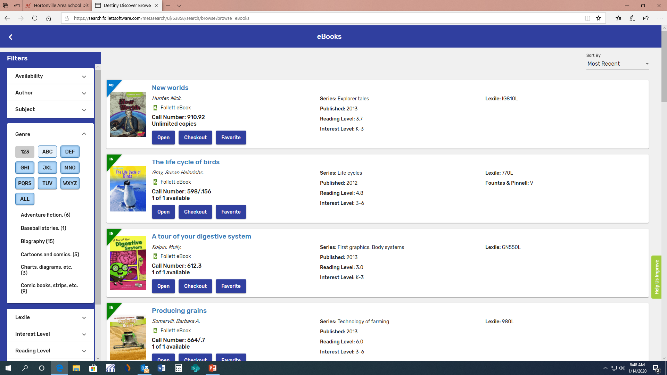

We can filter by different categories
You can use the menu on the left to look for different kinds of books
Click on “GENRE”, then click on “all” to see the categories of genre and how many BOOKS of each there are.

Slide 9
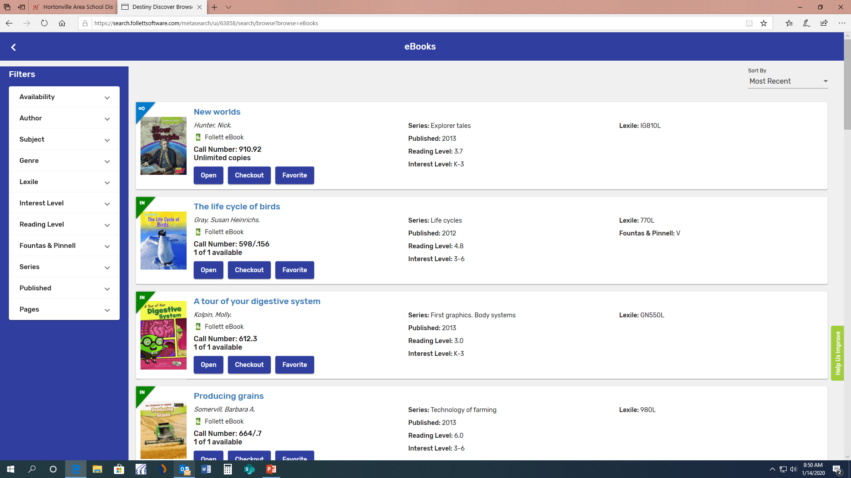
Types of Check Outs
The green “IN” on the corner of the book means that only one person may look at or check out the book at a time.
The blue “infinity” symbol on the corner of the book means that as many people as want may look at or check out the book.

Slide 10

Let’s press “Open” on the book “The life cycle of birds”.

Slide 11
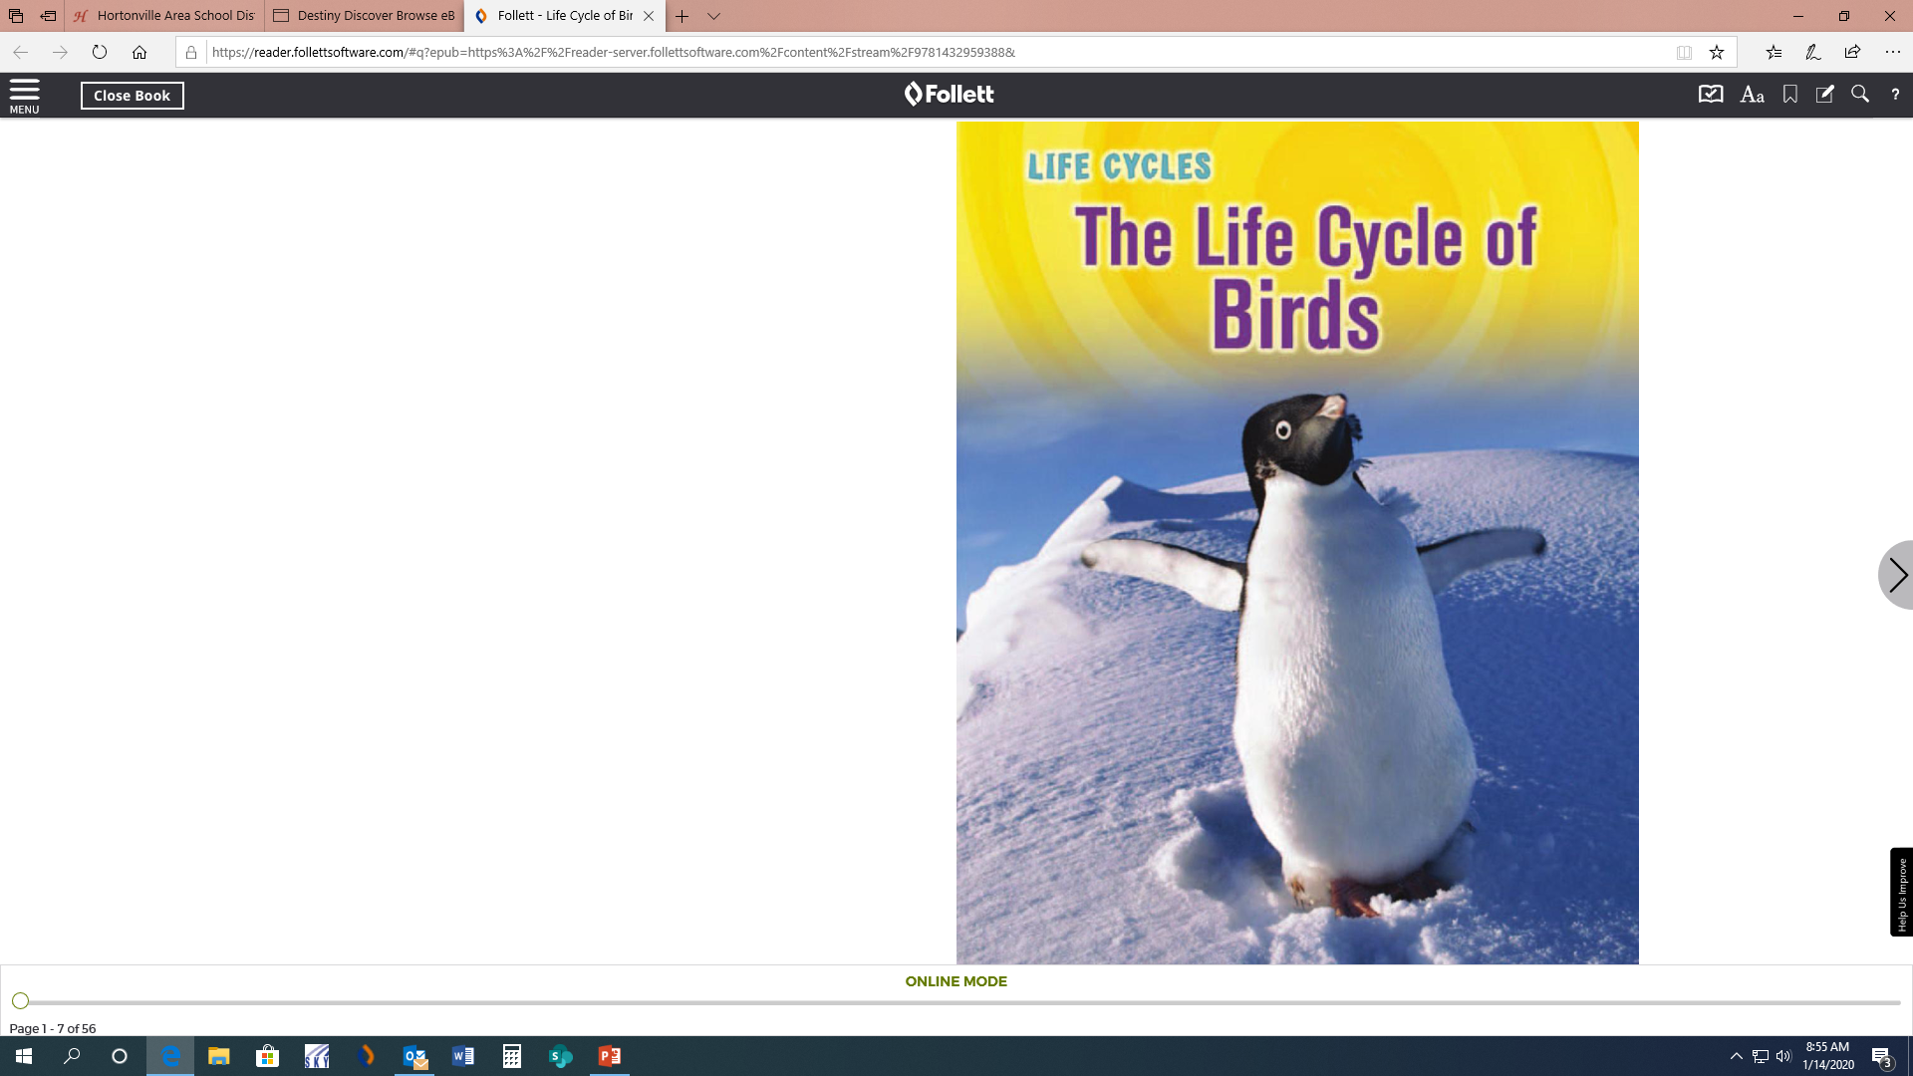
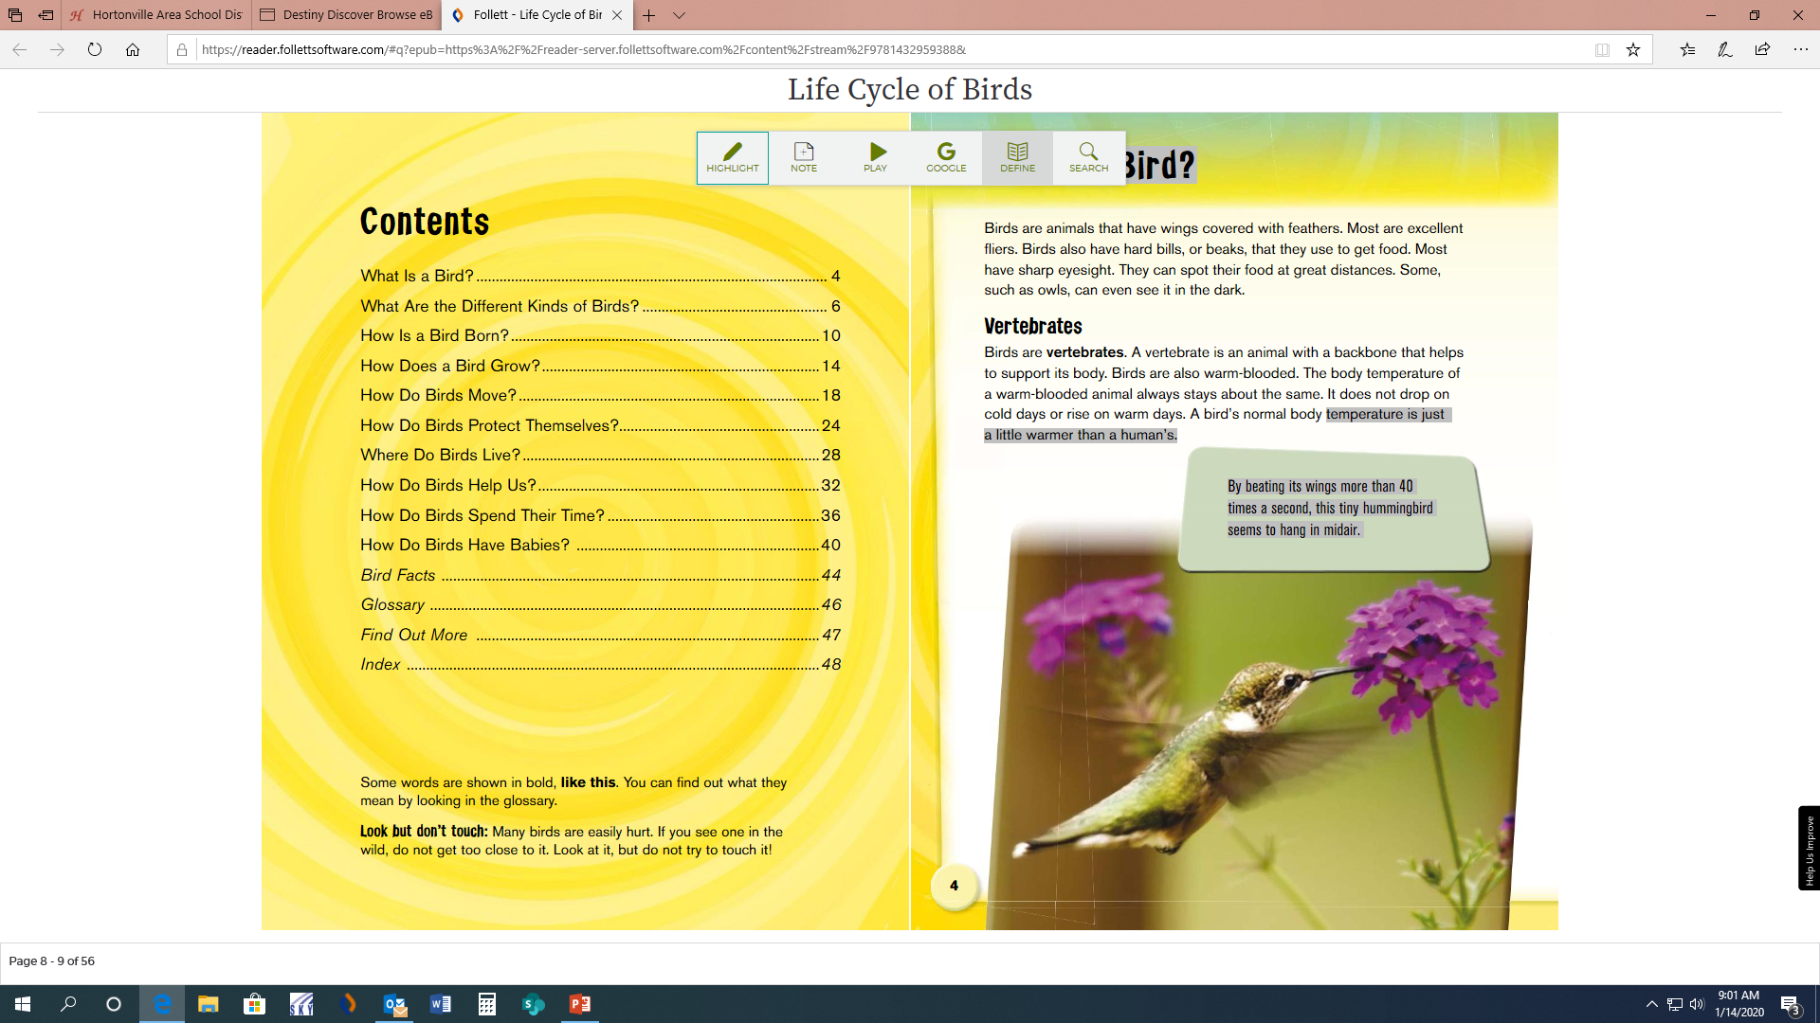
Example of an eBook
The book will open to the cover.
Turn the pages BY PRESSING THE ARROW KEY until you come to the first page of writing.
You can highlight passages by clicking and holding down until the highlight starts, then drag until the end of what you want to highlight.

Slide 12
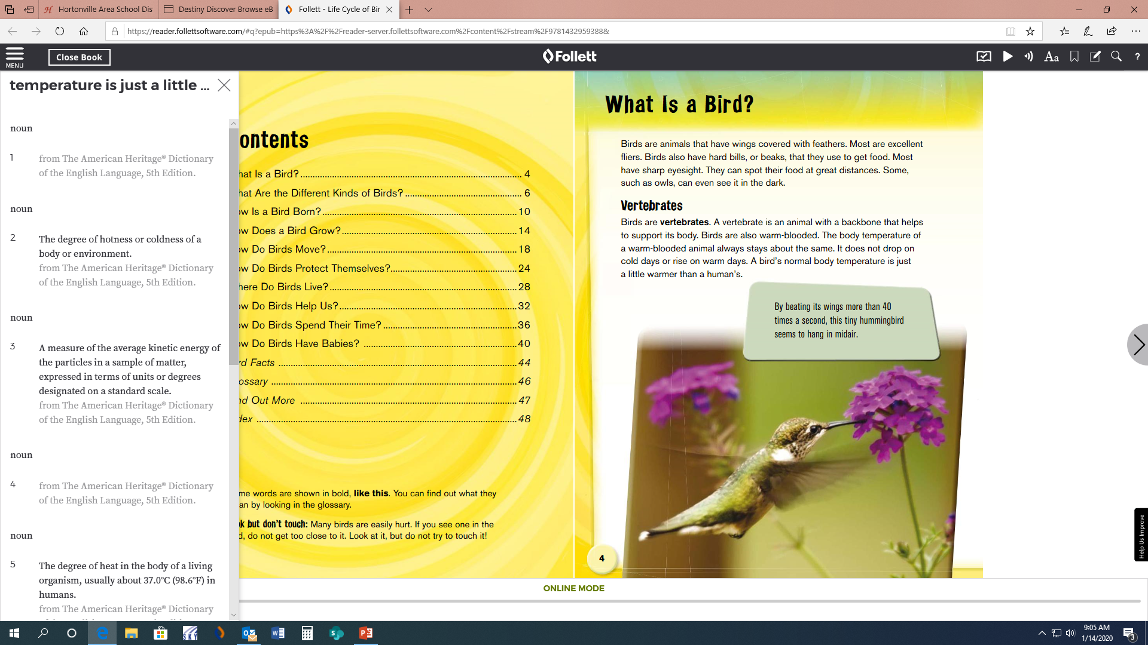
Highlight to look up word definitions in the dictionary
Double Click on THE word to highlight it.
Click on “Define” for THE dictionary.
When you open the dictionary, it will normally give you definitions unless it is not in the follett dictionary.

Slide 13
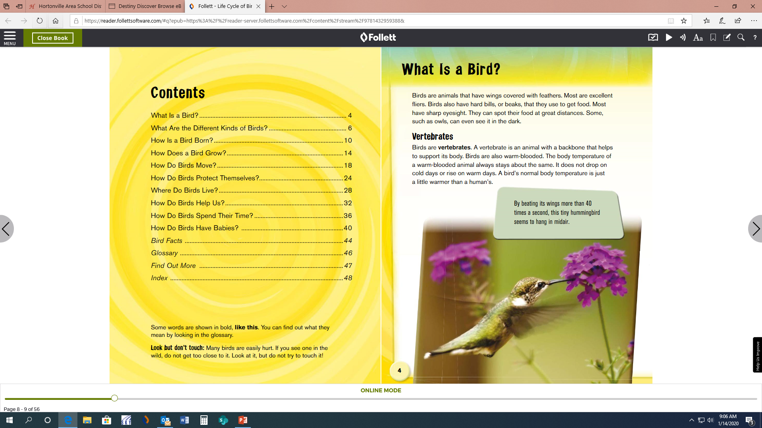
Let’s go ahead and close the book by pressing the “Close Book” button in the upper left corner.

Slide 14
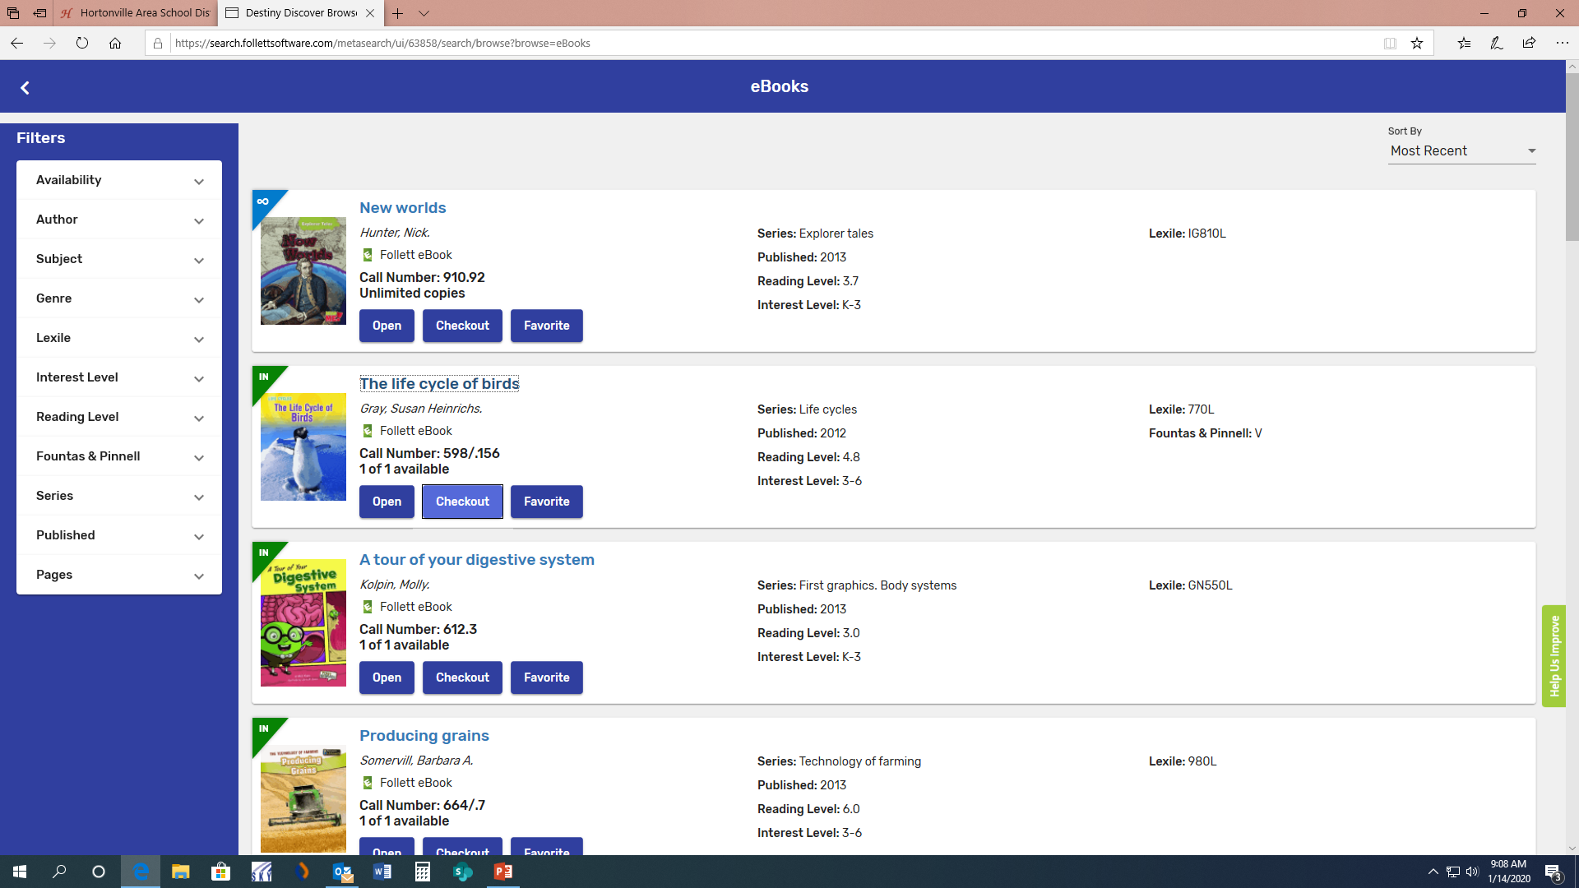
You can check out a book by clicking “Checkout”. eBooks can be checked out for 7 days.

Slide 15

Returning a Checked Out eBook
You can return an eBook on this screen by selecting “Return”. There is no need to “Checkout” an eBook if you are going to read it all at once. You can just open it and read it.

Slide 16
Some Rules for Using eBooks at NGES
You may check out one eBook at a time.
eBooks may be checked out for 7 days only.
Have fun reading and exploring☺!

